Slide 1
HISTORY OF MICROPROCESSORS

Slide 2
CONTENTS
Introduction
4-Bit Microprocessors
8-Bit Microprocessors
16-Bit Microprocessors
32-Bit Microprocessors
64-Bit Microprocessors

Slide 3
INTRODUCTION
Fairchild Semiconductors (founded in 1957) invented the first IC in 1959.
In 1968, Robert Noyce, Gordan Moore, Andrew Grove resigned from Fairchild Semiconductors.
They founded their own company Intel (Integrated Electronics).
Intel grown from 3 man start-up in 1968 to industrial giant by 1981.
It had 20,000 employees and $188 million revenue.

Slide 4
4-BIT MICROPROCESSORS

Slide 5
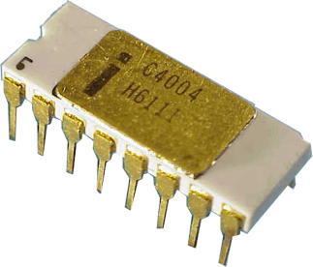
INTEL 4004
Introduced in 1971.
It was the first microprocessor by Intel.
It was a 4-bit µP.
Its clock speed was 740KHz.
It had 2,300 transistors.
It could execute around 60,000 instructions per second.

Slide 6
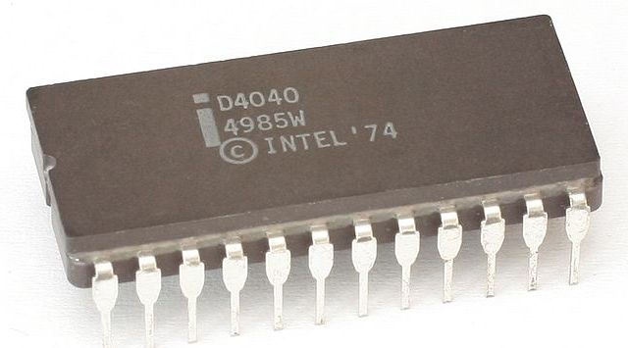
INTEL 4040
Introduced in 1974.
It was also 4-bit µP.

Slide 7
8-BIT MICROPROCESSORS

Slide 8
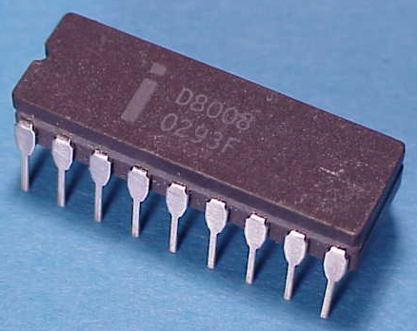
INTEL 8008
Introduced in 1972.
It was first 8-bit µP.
Its clock speed was 500 KHz.
Could execute 50,000 instructions per second.

Slide 9
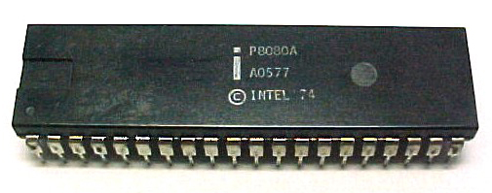
INTEL 8080
Introduced in 1974.
It was also 8-bit µP.
Its clock speed was 2 MHz.
It had 6,000 transistors.
Was 10 times faster than 8008.
Could execute 5,00,000 instructions per second.

Slide 10
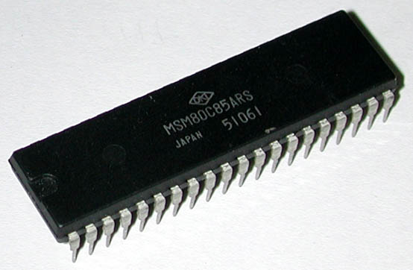
INTEL 8085
Introduced in 1976.
It was also 8-bit µP.
Its clock speed was 3 MHz.
Its data bus is 8-bit and address bus is 16-bit.
It had 6,500 transistors.
Could execute 7,69,230 instructions per second.
It could access 64 KB of memory.
It had 246 instructions.
Over 100 million copies were sold.

Slide 11
16-BIT MICROPROCESSORS

Slide 12
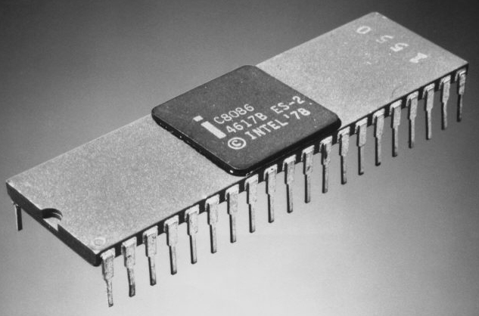
INTEL 8086
Introduced in 1978.
It was first 16-bit µP.
Its clock speed is 4.77 MHz, 8 MHz and 10 MHz, depending on the version.
Its data bus is 16-bit and address bus is 20-bit.
It had 29,000 transistors.
Could execute 2.5 million instructions per second.
It could access 1 MB of memory.
It had 22,000 instructions.
It had Multiply and Divide instructions.

Slide 13
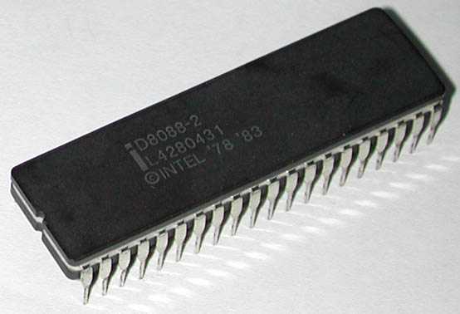
INTEL 8088
Introduced in 1979.
It was also 16-bit µP.
It was created as a cheaper version of Intel’s 8086.
It was a 16-bit processor with an 8-bit external bus.
Could execute 2.5 million instructions per second.
This chip became the most popular in the computer industry when IBM used it for its first PC.

Slide 14
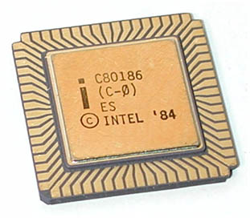
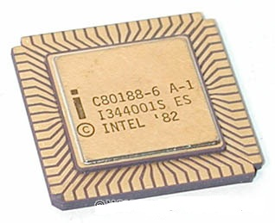
INTEL 80186 & 80188
Introduced in 1982.
They were 16-bit µPs.
Clock speed was 6 MHz.
80188 was a cheaper version of 80186 with an 8-bit external data bus.
They had additional components like:
  Interrupt Controller
  Clock Generator
  Local Bus Controller
  Counters

Slide 15
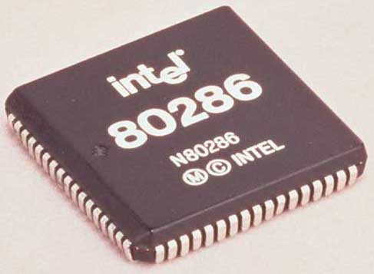
INTEL 80286
Introduced in 1982.
It was 16-bit µP.
Its clock speed was 8 MHz.
Its data bus is 16-bit and address bus is 24-bit.
It could address 16 MB of memory.
It had 1,34,000 transistors.
It could execute 4 million instructions per second.

Slide 16
32-BIT MICROPROCESSORS

Slide 17
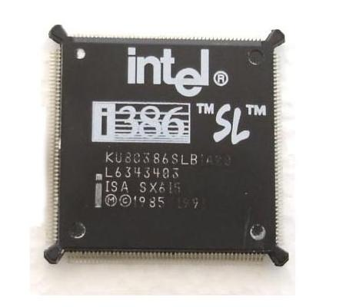
INTEL 80386
Introduced in 1986.
It was first 32-bit µP.
Its data bus is 32-bit and address bus is 32-bit.
It could address 4 GB of memory.
It had 2,75,000 transistors.
Its clock speed varied from 16 MHz to 33 MHz depending upon the various versions.
Different versions:
  80386 DX
  80386 SX
  80386 SL
Intel 80386 became the best selling microprocessor in history.

Slide 18
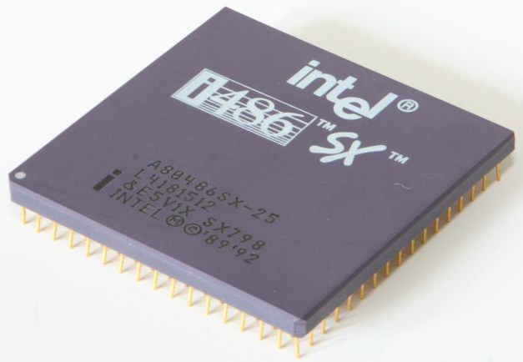
INTEL 80486
Introduced in 1989.
It was also 32-bit µP.
It had 1.2 million transistors.
Its clock speed varied from 16 MHz to 100 MHz depending upon the various versions.
It had five different versions:
  80486 DX
  80486 SX
  80486 DX2
  80486 SL
  80486 DX4
8 KB of cache memory was introduced.

Slide 19
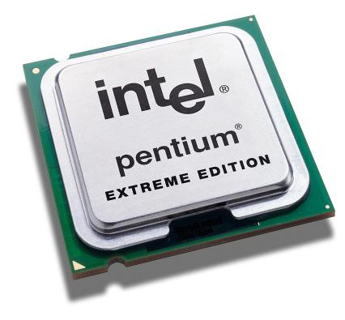
INTEL PENTIUM
Introduced in 1993.
It was also 32-bit µP.
It was originally named 80586.
Its clock speed was 66 MHz.
Its data bus is 32-bit and address bus is 32-bit.
It could address 4 GB of memory.
Could execute 110 million instructions per second.
Cache memory:
  8 KB for instructions.
  8 KB for data.

Slide 20
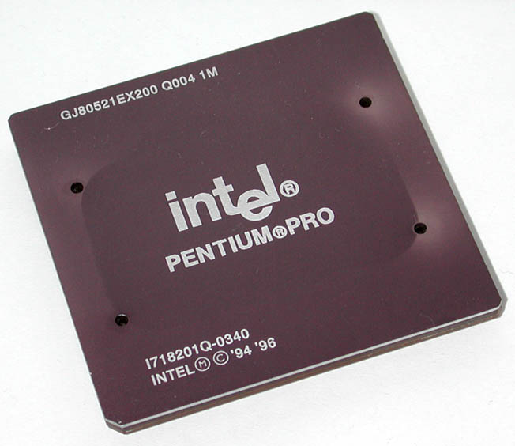
INTEL PENTIUM PRO
Introduced in 1995.
It was also 32-bit µP.
It had L2 cache of 256 KB.
It had 21 million transistors.
It was primarily used in server systems.
Cache memory:
  8 KB for instructions.
  8 KB for data.
It had L2 cache of 256 KB.

Slide 21
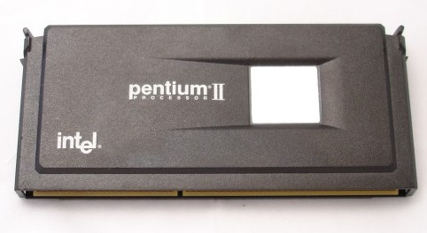
INTEL PENTIUM II
Introduced in 1997.
It was also 32-bit µP.
Its clock speed was 233 MHz to 500 MHz.
Could execute 333 million instructions per second.
MMX technology was supported.
L2 cache & processor were on one circuit.

Slide 22
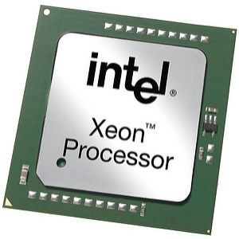
INTEL PENTIUM II XEON
Introduced in 1998.
It was also 32-bit µP.
It was designed for servers.
Its clock speed was 400 MHz to 450 MHz.
L1 cache of 32 KB & L2 cache of 512 KB, 1MB or 2 MB.
It could work with 4 Xeons in same system.

Slide 23
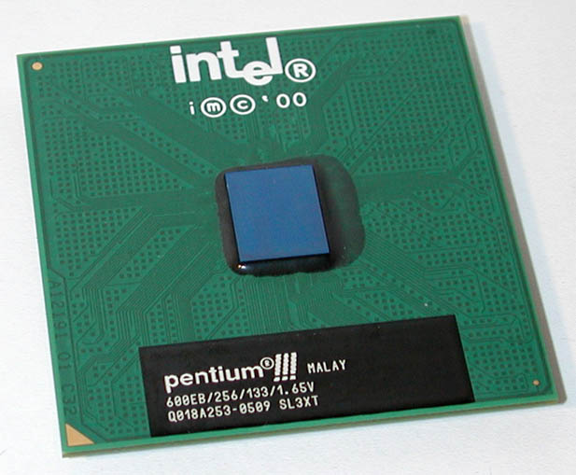
INTEL PENTIUM III
Introduced in 1999.
It was also 32-bit µP.
Its clock speed varied from 500 MHz to 1.4 GHz.
It had 9.5 million transistors.

Slide 24
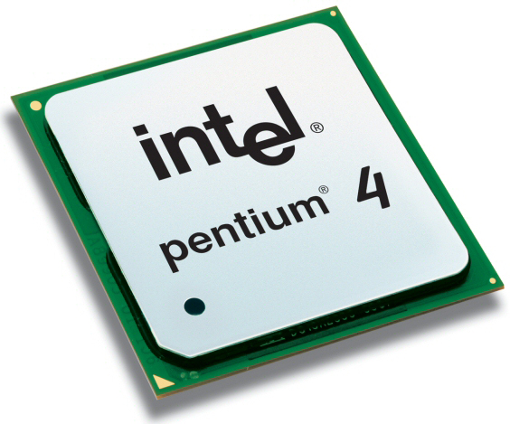
INTEL PENTIUM IV
Introduced in 2000.
It was also 32-bit µP.
Its clock speed was from 1.3 GHz to 3.8 GHz.
L1 cache was of 32 KB & L2 cache of 256 KB.
It had 42 million transistors.
All internal connections were made from aluminium to copper.

Slide 25
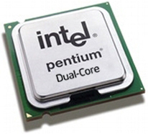
INTEL DUAL CORE
Introduced in 2006.
It is 32-bit or 64-bit µP.
It has two cores.
Both the cores have there own internal bus and L1 cache, but share the external bus and L2 cache (Next Slide).
It supported SMT technology.
SMT: Simultaneously Multi-Threading
E.g.: Adobe Photoshop supported SMT.

Slide 26
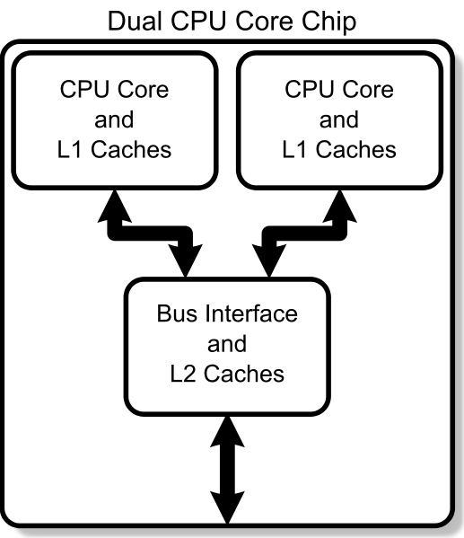

Slide 27
64-BIT MICROPROCESSORS

Slide 28
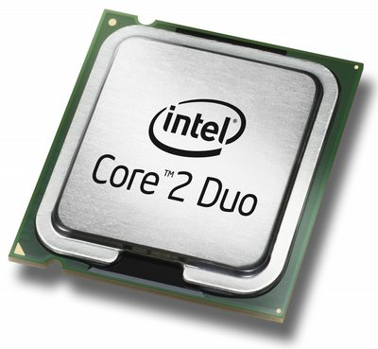
INTEL CORE 2
Introduced in 2006.
It is a 64-bit µP.
Its clock speed is from 1.2 GHz to 3 GHz.
It has 291 million transistors.
It has 64 KB of L1 cache per core and 4 MB of L2 cache.
It is launched in three different versions:
  Intel Core 2 Duo
  Intel Core 2 Quad
  Intel Core 2 Extreme

Slide 29
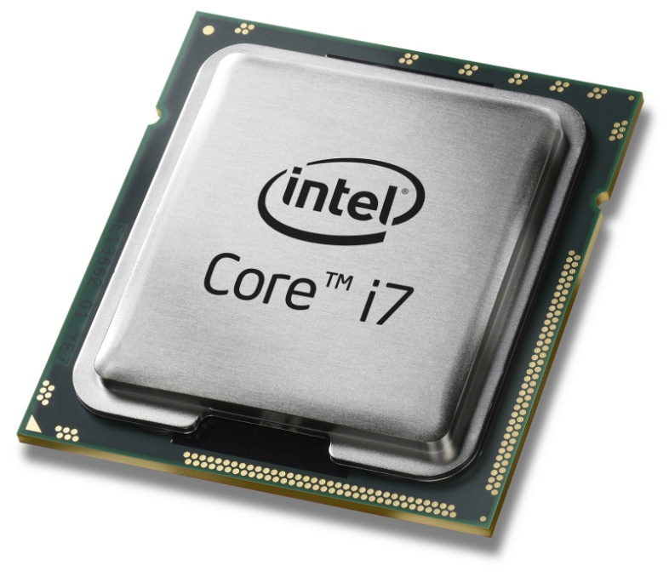
INTEL CORE i7
Introduced in 2008.
It is a 64-bit µP.
It has 4 physical cores.
Its clock speed is from 2.66 GHz to 3.33 GHz.
It has 781 million transistors.
It has 64 KB of L1 cache per core, 256 KB of L2 cache and 8 MB of L3 cache.

Slide 30
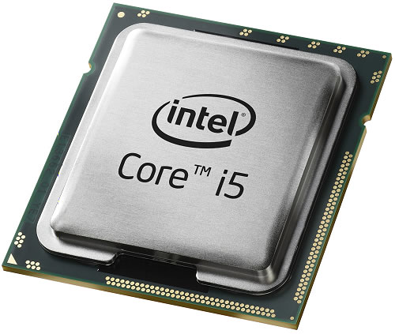
INTEL CORE i5
Introduced in 2009.
It is a 64-bit µP.
It has 4 physical cores.
Its clock speed is from 2.40 GHz to 3.60 GHz.
It has 781 million transistors.
It has 64 KB of L1 cache per core, 256 KB of L2 cache and 8 MB of L3 cache.

Slide 31
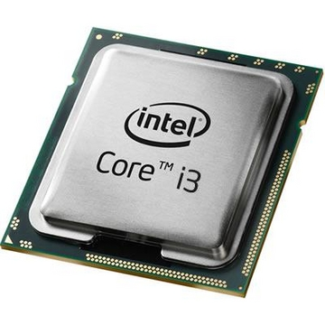
INTEL CORE i3
Introduced in 2010.
It is a 64-bit µP.
It has 2 physical cores.
Its clock speed is from 2.93 GHz to 3.33 GHz.
It has 781 million transistors.
It has 64 KB of L1 cache per core, 512 KB of L2 cache and 4 MB of L3 cache.

Slide 32




